Slide 1
Mutual Fund Analytics Capstone Project
Bluestock Internship Program
Prepared By:
Vali Shaik
Duration:
01 June 2026 – 10 June 2026
Tools Used:
Python • SQLite • Pandas • Power BI • Git

Slide 2
Problem Statement
The mutual fund industry generates large volumes of financial and investor data.
However, investors and analysts often struggle to:
• Compare mutual fund performance
• Evaluate risk-adjusted returns
• Understand investor behavior
• Monitor SIP growth trends
• Identify suitable investment opportunities
A centralized analytics solution was required to transform raw data into actionable insights.

Slide 3
Project Objectives
• Build an end-to-end analytics pipeline
• Clean and integrate multiple mutual fund datasets
• Perform exploratory data analysis
• Calculate financial performance metrics
• Develop interactive dashboards
• Conduct advanced risk analytics
• Generate investment recommendations

Slide 4
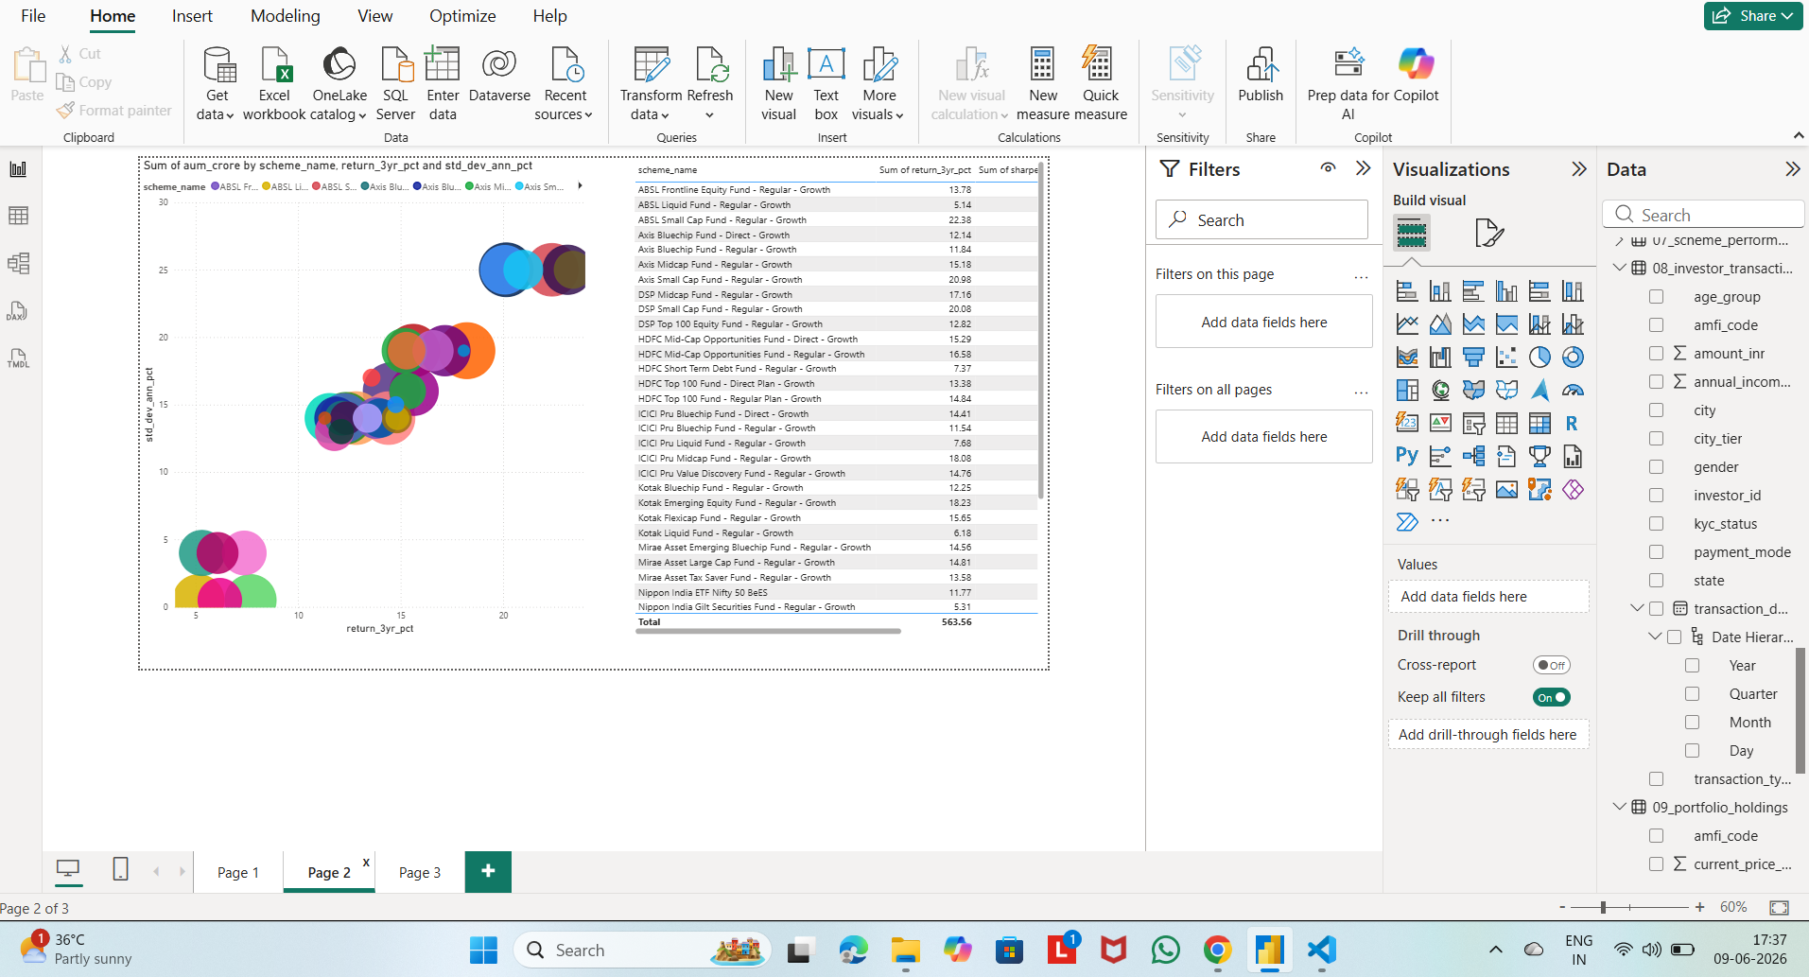
Data Sources
10 datasets were utilized:
• Fund Master
• NAV History
• AUM by Fund House
• Monthly SIP Inflows
• Category Inflows
• Industry Folio Count
• Scheme Performance
• Investor Transactions
• Portfolio Holdings
• Benchmark Indices

Slide 5
Project Workflow
Raw CSV Files
↓
ETL Pipeline
↓
Data Cleaning
↓
SQLite Database
↓
EDA & Analytics
↓
Power BI Dashboard
↓
Insights & Recommendations

Slide 6
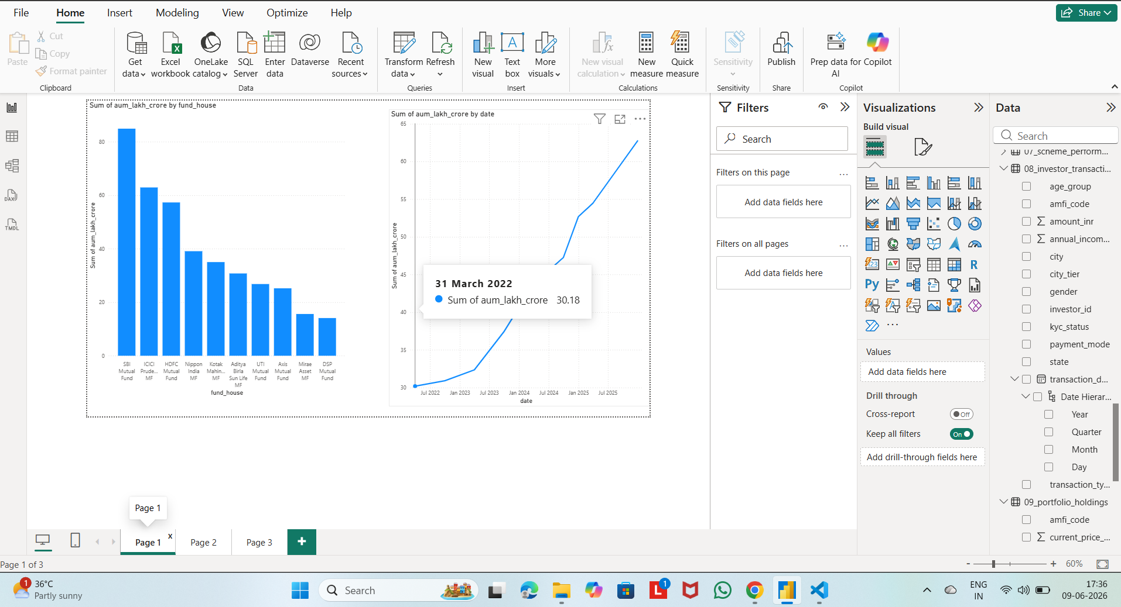
EDA Highlights
Key Insights:
• SIP inflows increased steadily
• Industry AUM continued to grow
• Category inflows varied significantly
• Benchmark trends reflected market movements

Slide 7
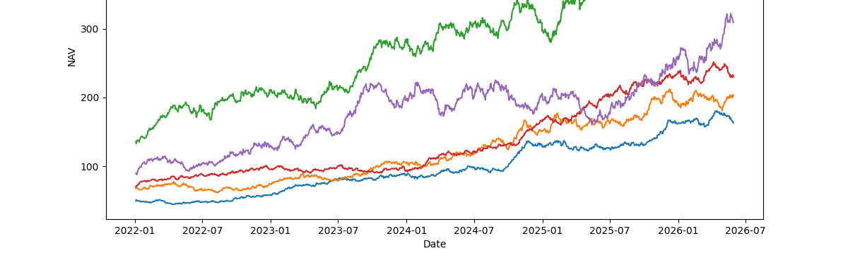
Performance Metrics
Metrics Calculated:
• Alpha
• Beta
• Sharpe Ratio
• Sortino Ratio
• Maximum Drawdown
Outcome:
Created a comprehensive fund scorecard for ranking and comparing mutual fund schemes.

Slide 8
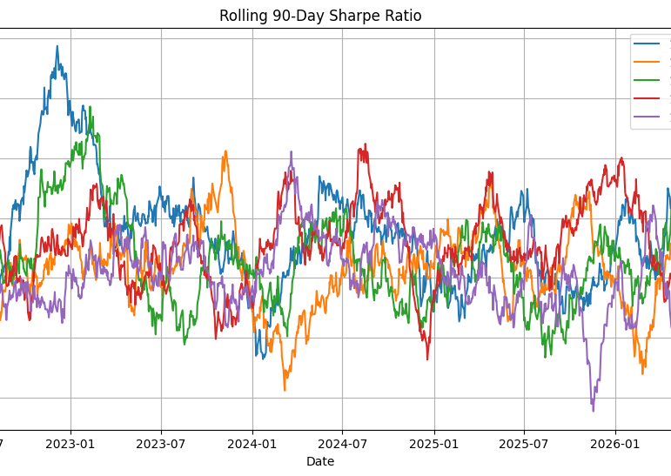
Advanced Analytics
Implemented:
• Historical VaR (95%)
• Conditional VaR (95%)
• Rolling 90-Day Sharpe Ratio
• SIP Continuity Analysis
• Investor Cohort Analysis
• Fund Recommendation Engine
• HHI Concentration Analysi

Slide 9
Power BI Dashboard

Slide 10
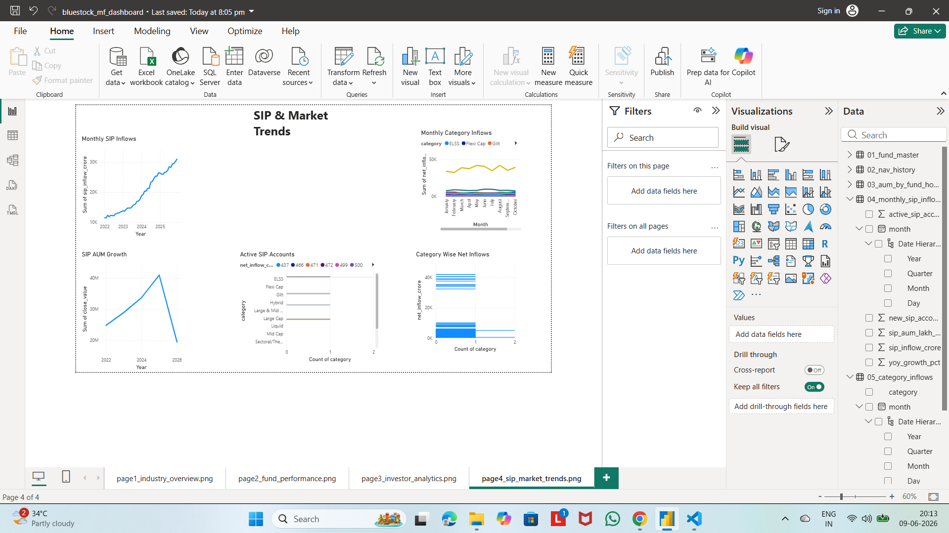
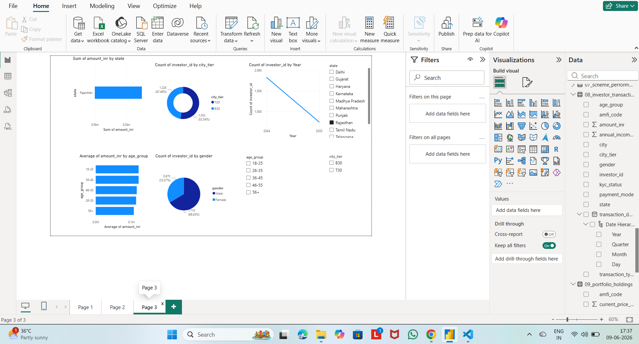
Power BI Dashboard

Slide 11
Key Findings
• Moderate-risk funds achieved the best risk-adjusted performance.
• SIP inflows showed strong long-term growth.
• Several investors were identified as at-risk due to irregular SIP contributions.
• Portfolio concentration varies significantly across funds.
• VaR and CVaR identified schemes with higher downside risk.

Slide 12
Conclusion
Successfully developed an end-to-end Mutual Fund Analytics platform integrating:
• ETL Pipeline
• Database Design
• Exploratory Analysis
• Performance Evaluation
• Advanced Risk Analytics
• Interactive Dashboard
Thank You

